Slide 1
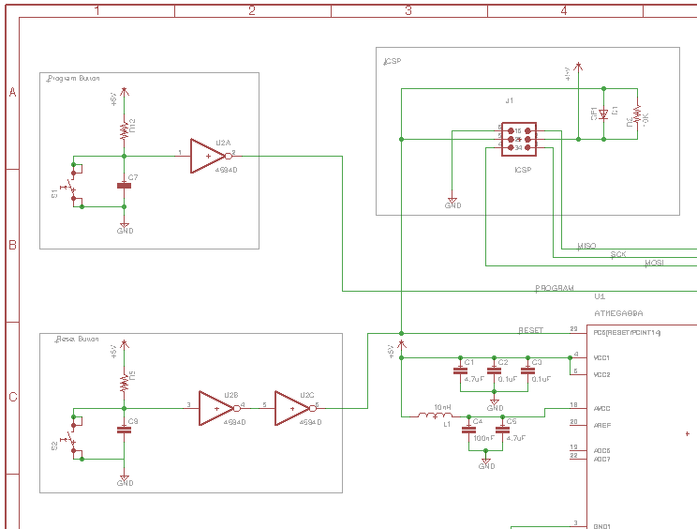
Implementation
We began the circuit design after creating system requirements and figuring out what type of functionality is required from the hardware.
Specified sub-circuits in the system and designed each in a modular fashion.
Obstacles that where overcome, in this stage of the project include (eagle learning curve, Github crashes and general circuit troubleshooting).

Slide 2
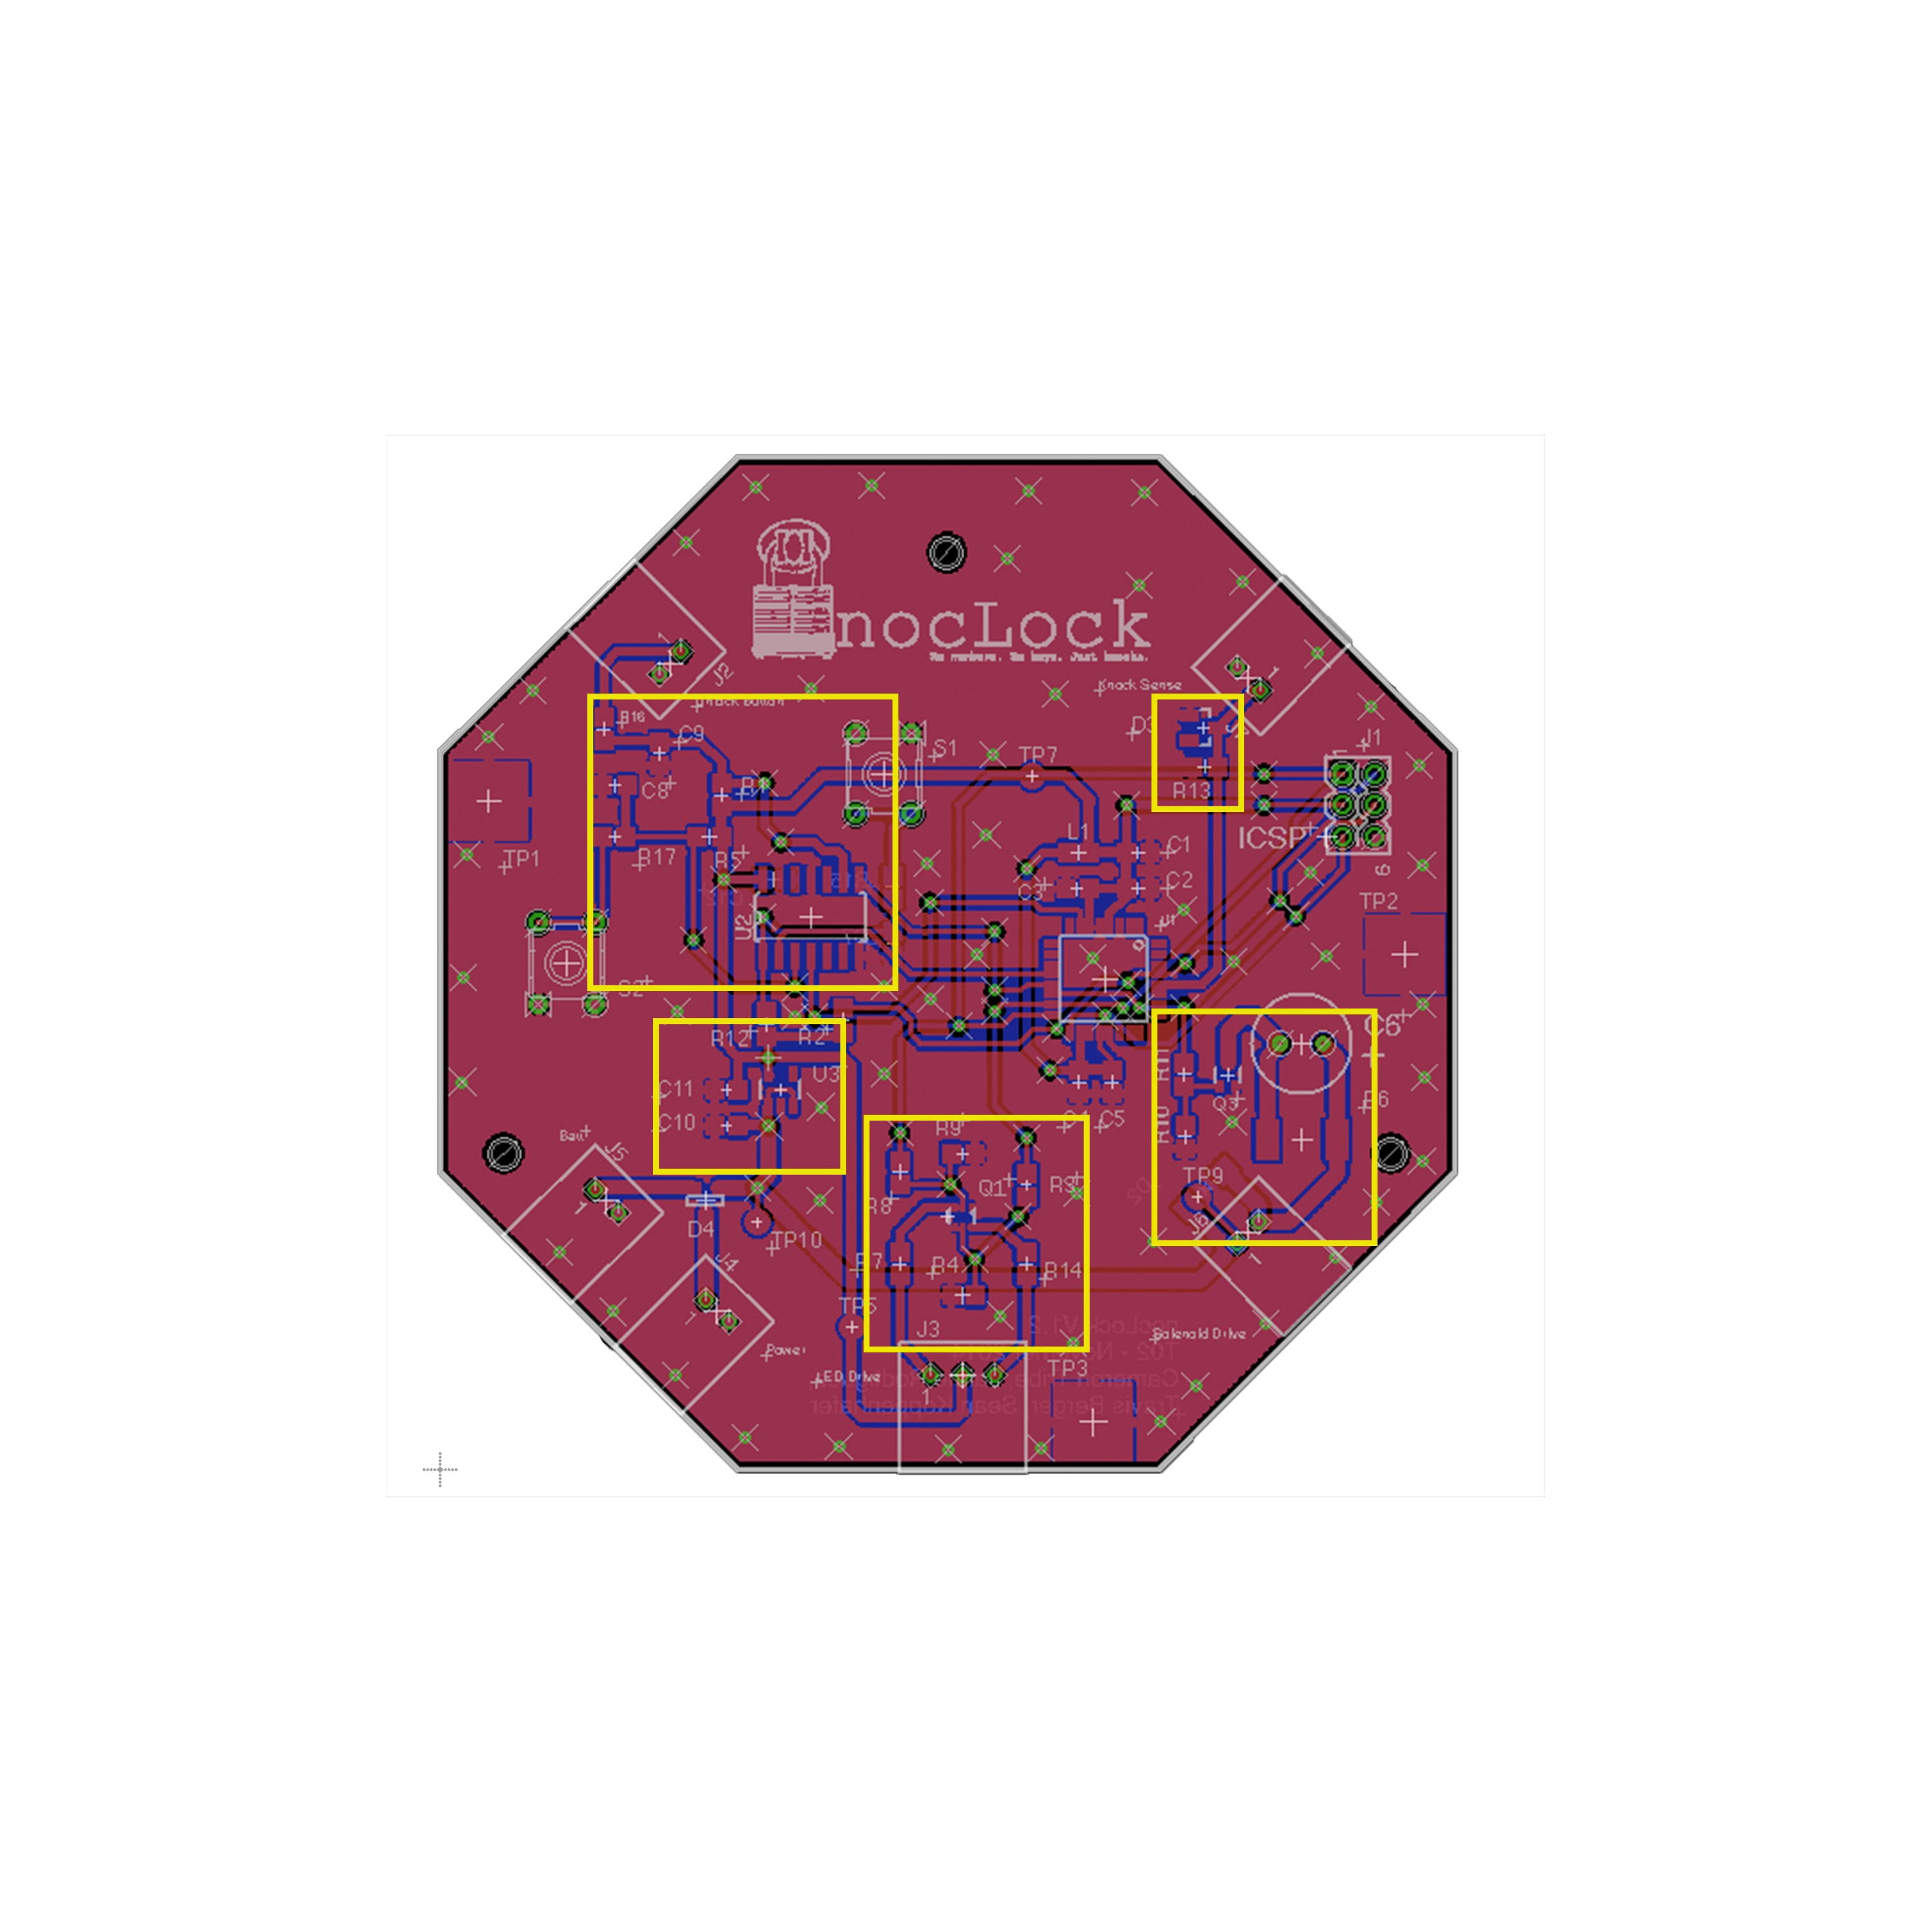
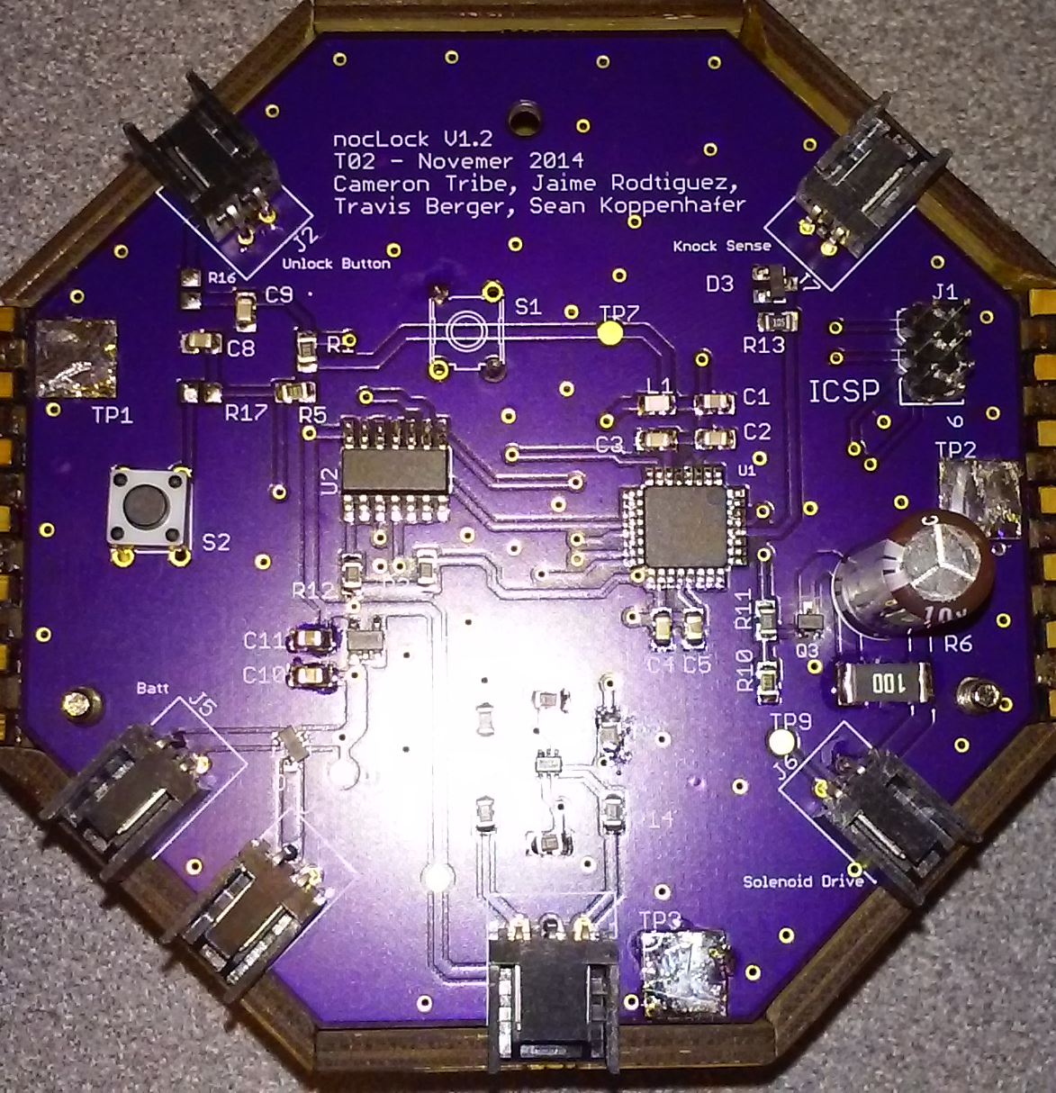
Board Layout
Because this project is more of a novelty than a serious product we wanted to show off and be creative every chance we got, this is just one example.
Button
Inputs
Sensor
input
Power
Supply
Solenoid
LED’s

Slide 3
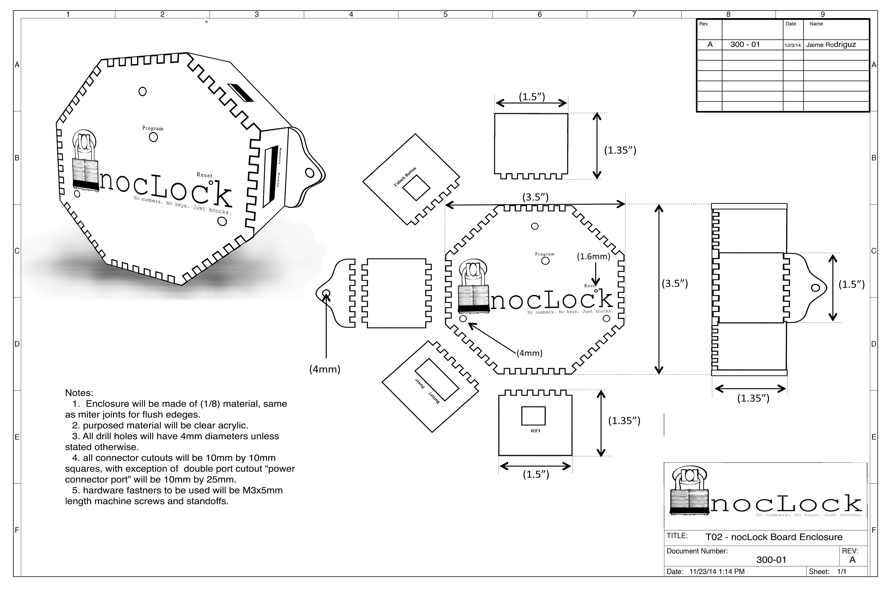
Board Enclosure

Slide 4
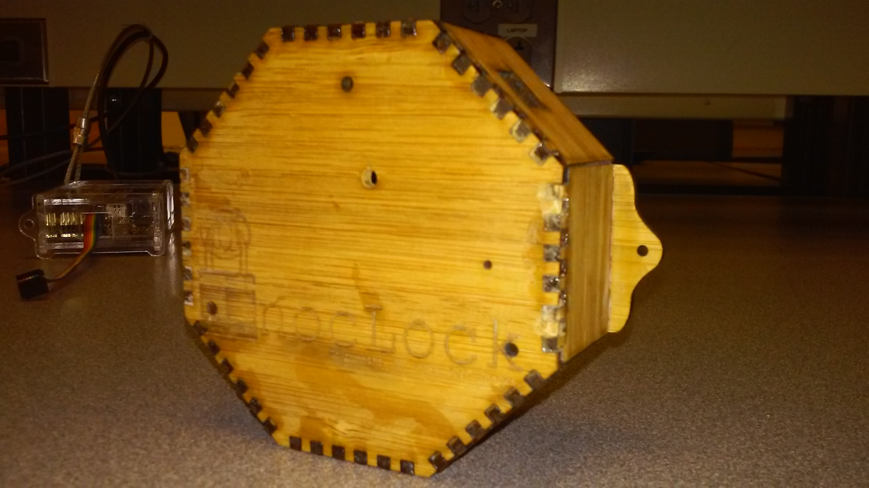

Slide 5
Button
Inputs
Sensor
input
Power
Supply
Solenoid
LED’s

